Slide 1
DCC Speed Matching Technique
Lee Williams

Slide 2
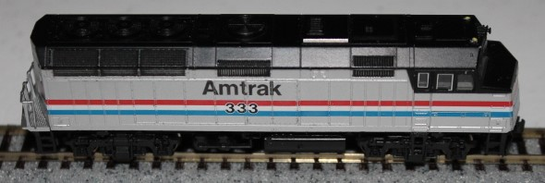
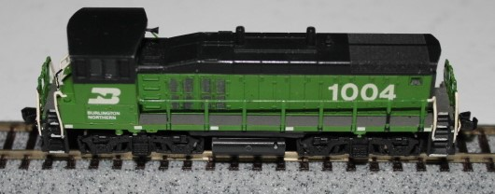
Locomotive Catagories
Passenger
Mainline Freight
Switcher
Notes:
Due to different speeds, don’t try to speed match across categories.

Slide 3
DCC Programming Modes
Programming Track
Read a Configuration Variables (CVs)
Write all CVs including DCC address
Limited to one locomotive on programming track at a tim

Slide 4
DCC Programming Modes
Programming on Main
Run and program on same track
Program a specific locomotive with multiple locomotives on track
Can’t read locomotive CVs
Can change DCC address
Notes:
You can even change speed CVs while the locomotive is running.

Slide 5
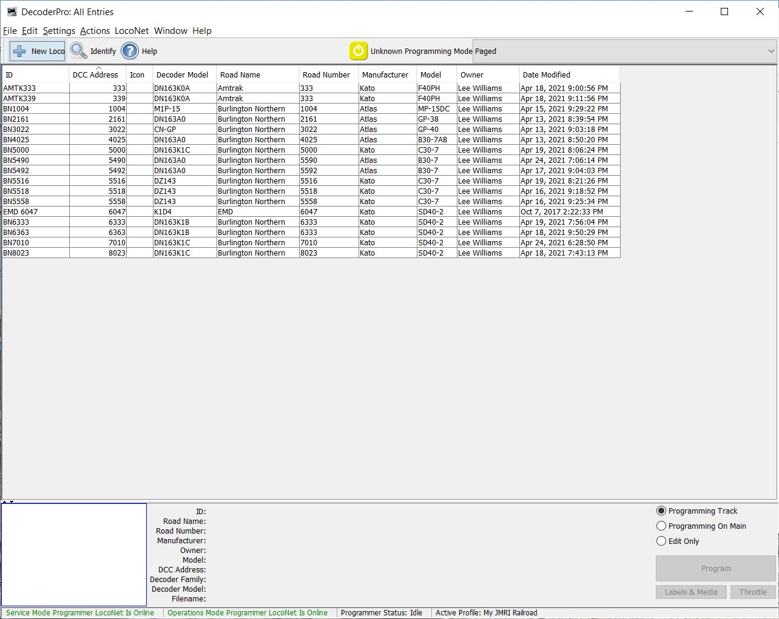
JMRI / Programming Track
Notes:
Here is an example of starting programming track mode with JMRI.

Slide 6
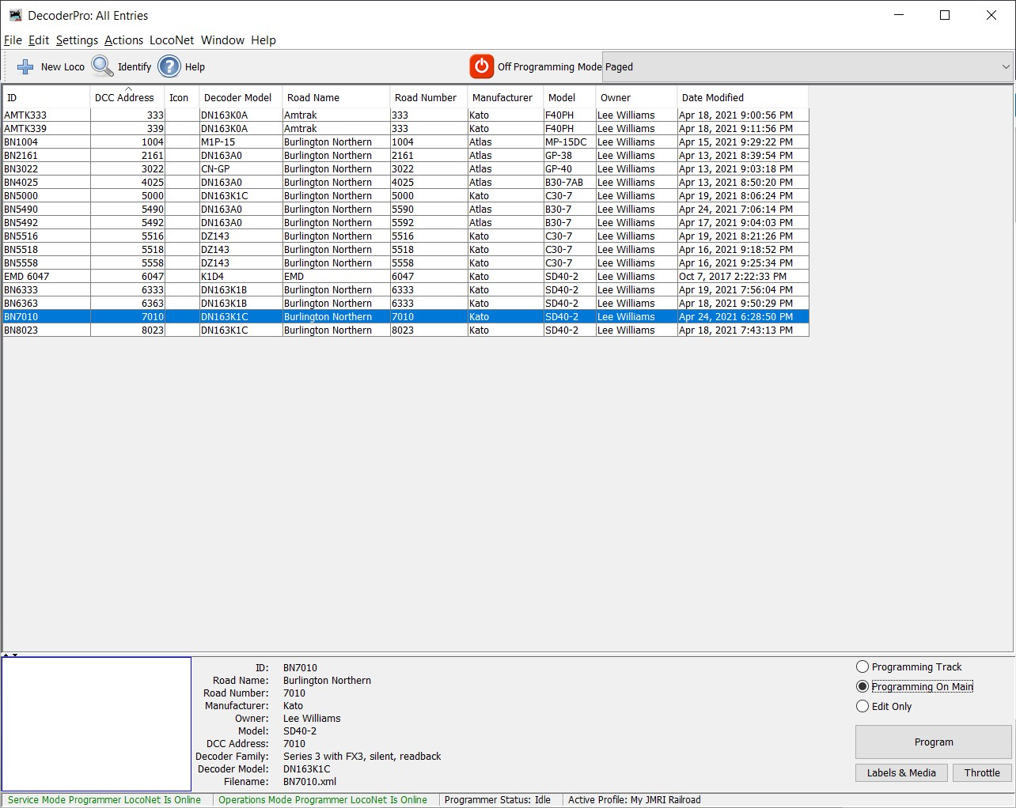
JMRI / Programming on Main
Notes:
To program on main, you have to first select the locomotive you will program from the JMRI roster.

Slide 7
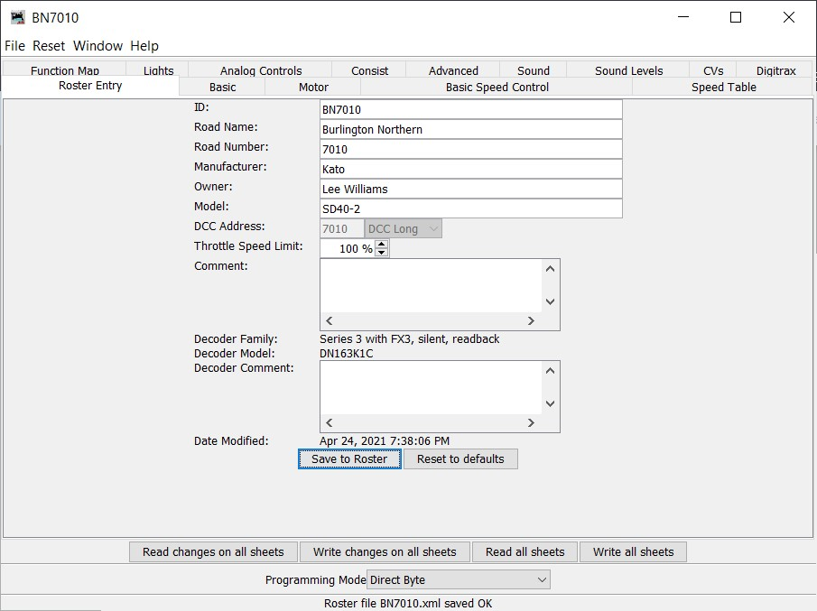
JMRI / Programming on Main
Notes:
On the Roster Entry tab, note the DCC Address of the locomotive being programmed.

Slide 8
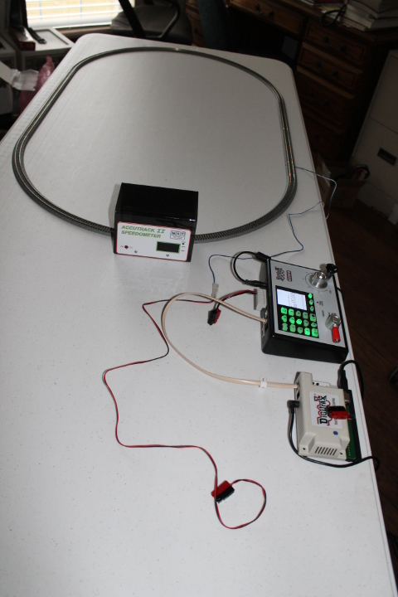
DCC Speed Matching Setup
Loop of Kato Unitrack
Digitrax DCS 52
Digitrax PR3
Accutrack II Spedometer
Laptop with MRI
Notes:
Here is the DCC speed matching setup using the components that I have.
Other command stations, loconet interface and throttle will work as long as either the loconet interface or the command station has a programming track interface.
Thanks to Carl Wessel for loaning me his speedometer.

Slide 9
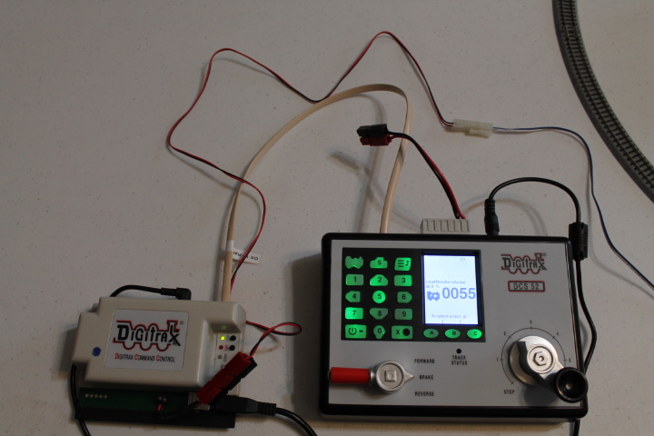
DCC Speed Matching Setup
Notes:
The PR3 and DCS 52 are connected by a loconet cable.
I made an Anderson Powerpole connecter for both the PR3 and the DCS 52.
I made a Kato to Anderson Powerpole adapter to connect to the track.
This lets me easily change the track connection between the programming track on the PR3 to the run track on the DCS 52.
Shown here is the track connected to the PR3.

Slide 10
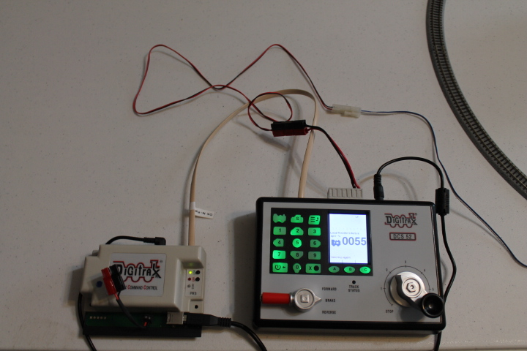
DCC Speed Matching Setup
Notes:
Here is the track connected to the DCS 52.

Slide 11
Locomotive Tune Up
Clean wheels
Clean mechanism
Gears & axles clear of lint & crud
Lubrication
Not too much
Check for smooth running
Notes:
Don’t try to speed match a poorly running locomotive.

Slide 12
Initial Setup
Programming Track
Plug track into PR3
Set PR3 to Program (green LED flashing)
Select Program Track In JMRI
Notes:
Three steps to start or switch to programming track mode.
The PR3 can be set to Programmer Mode (Loconet interface) by either the button on the PR3 or by the JMRI menu.

Slide 13
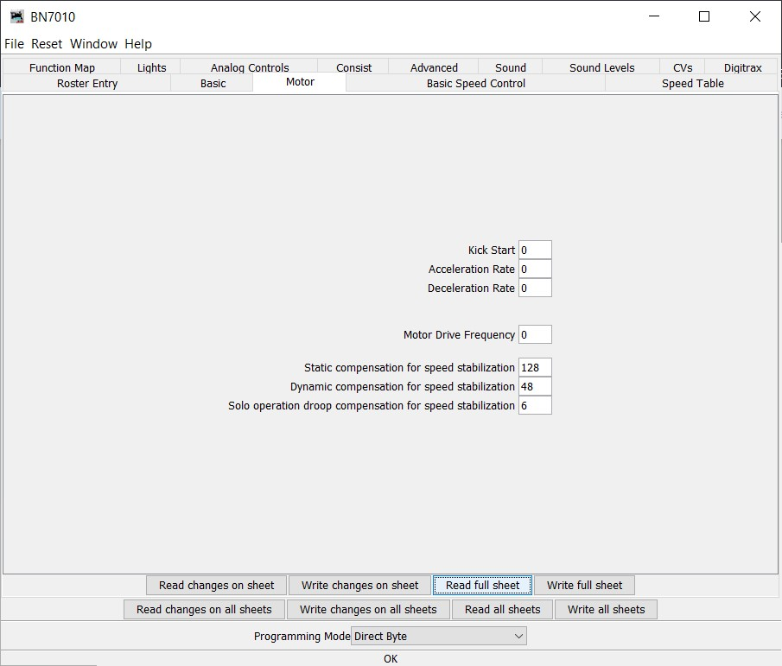
Initial Setup - Motor
Notes:
I start with the Kick Start (CV 65) set to zero.
I prefer controlling a smooth starts and stops my self, so I set Acceleration Rate (CV 3) and Deceleration Rate (CV 4) to zero. Use the same value for all of the locomotives you are speed matching.

Slide 14
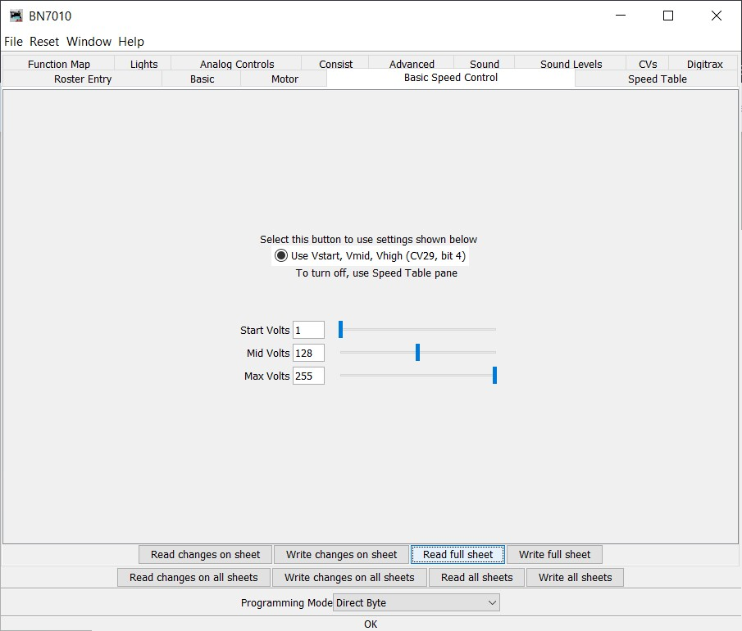
Initial Setup – Basic Speed
Notes:
Start Volts (CV 2), Mid Volts (CV 6) and Max Volts (CV 5) are the relative voltages the decoder provides to the motor at 1%, 50% and 99% throttle settings respectively.
This is the starting settings I use to determine the locomotive max speeds.
99% throttle with Max Volts set to 255 is the fastest a locomotive can run.

Slide 15
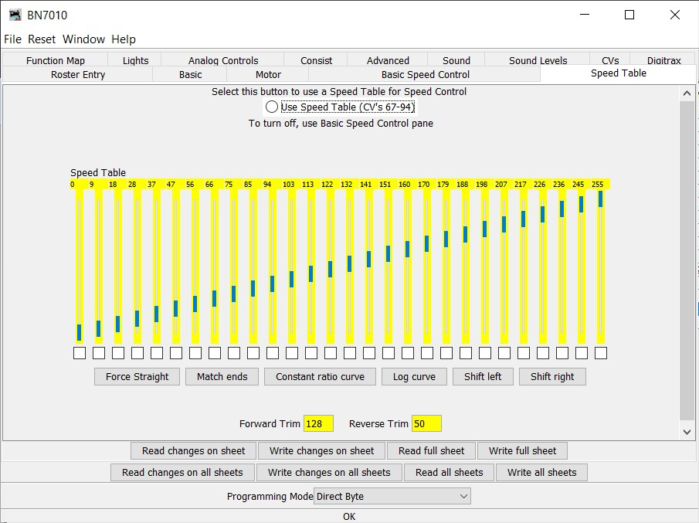
Initial Setup – Trim Settings
Notes:
Note the Forward Trim (CV 66) and the Reverse Trim (CV 95) need to initially be set to the same value.
The speed table has 28 values (CVs 67-94) corresponding to a 28 speed step decoder. The newer decoders have 128 speed steps.
You could speed match with this table. You’d need to determine which throttle setting correspond to each of the 28 speed steps, and it would take considerably longer.
This briefing is for using the Basic Speed Control.

Slide 16
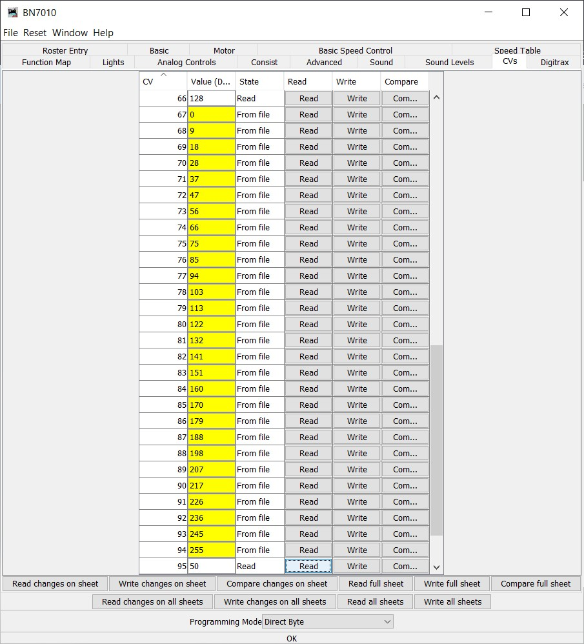
Initial Setup – Trim Settings
CV 66: Forward Trim
CV 95: Reverse Trim
Notes:
If you want to read the Forward Trim and Reverse Trim without reading the whole speed table, you can read CV 66 and CV 95 from the CVs tab.

Slide 17
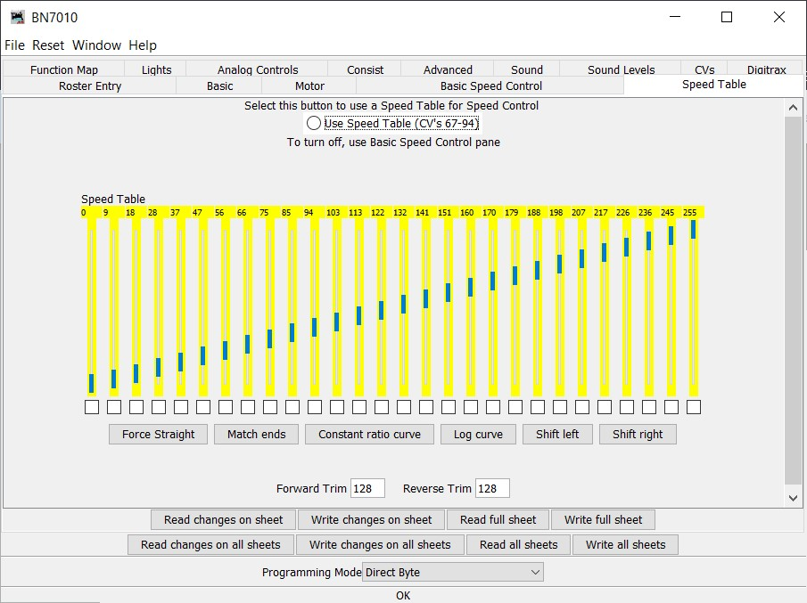
Initial Setup – Trim Settings
Notes:
Forward and Reverse Trim are set to the mid value 128.

Slide 18
Initial Setup – Save to Roster
Notes:
Be sure to save the locomotive settings to the roster, so you can use Programming on Main.

Slide 19
Loco Maximum Speeds
Plug track into DS 52
Run locomotive at max speed (99%) in both directions
Record maximum forward and reverse speeds
Notes:
First determine the maximum forward and reverse speeds of the locomotive.

Slide 20
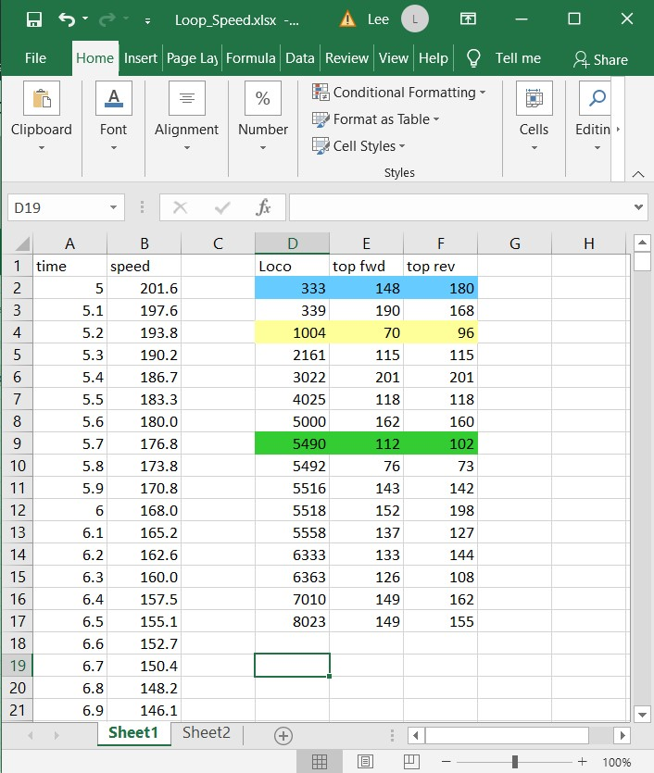
Loco Maximum Speeds
Notes:
I made a spread sheet of times and speeds in 1/10 sec increment for one lap of my speed matching loop as an alternative to using a speedometer.
Here is the recording of my DCC locomotive top speeds.
333 & 339 are passenger locomotives.
1004 is my only switcher.
The rest are main line freight locomotives.
I selected the slowest of each category (highlighted) as the master locomotive. You can slow down locomotives to match the max speed, but speed up a slower locomotive. Note that 5492 doesn’t run smoothly, so I won’t try to speed match it.

Slide 21
Set Master Loco Speeds
Programming Track
Plug track into DS 52
Set PR3 to Interface (green LED winking)
Select master loco from roster
Select Program on Main in JMRI
Notes:
Here are the four steps to switching to programming on main.
We’ll start with the master main line freight locomotive.

Slide 22
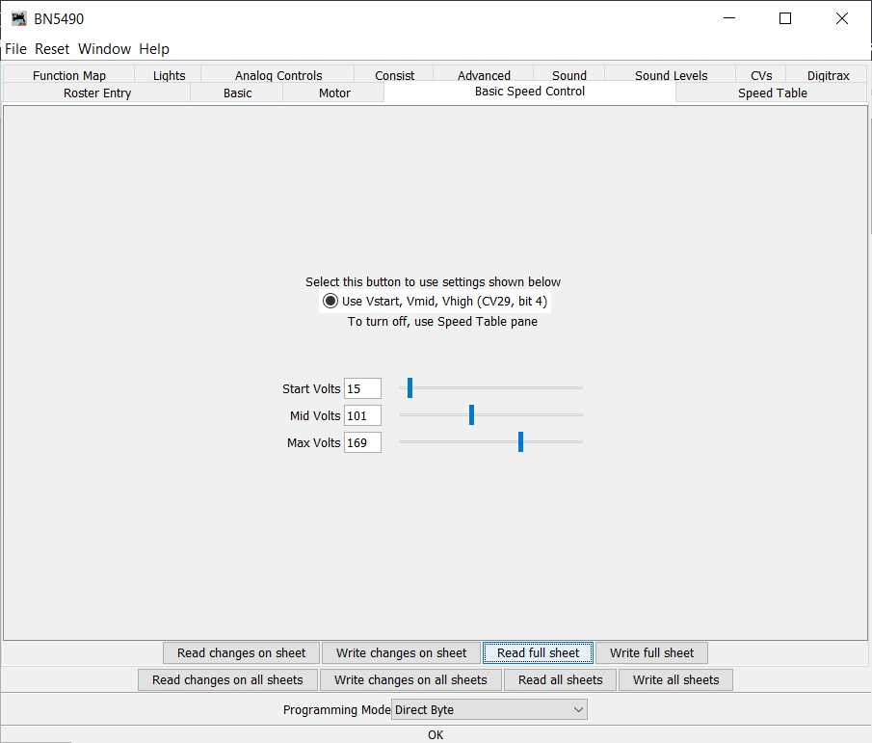
Set Master Loco Speeds
Adjust Max Volts for desired speed at 99%
E.g. 100 MPH
Adjust Mid Volts for desired speed at 50%
E.g 50 MPH
Adjust Start Volts so locomotive creeps at minimum speed at 1%
Notes:
I picked 100 MPH and 50 MPH as the max speed and mid speed.

Slide 23
Speed Match Loco to Master
Already in programming track mode
Select locomotive from roster
Select Program on Main in JMRI
Notes:
Now to finally speed match a locomotive: in this example 7010.

Slide 24
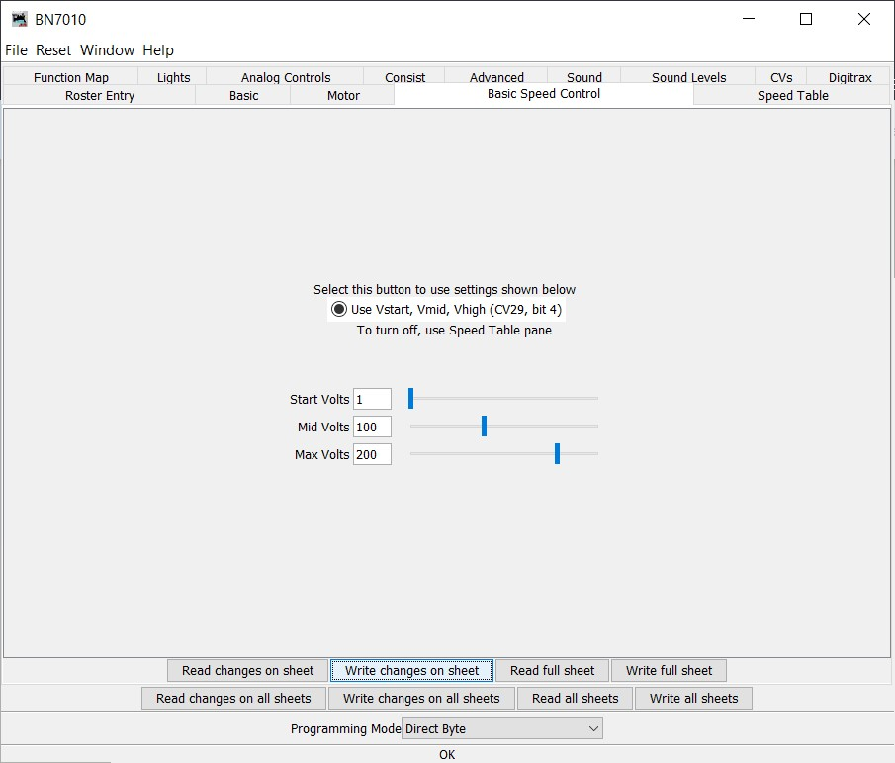
Speed Match Loco to Master
Adjust Max Volts for desired speed at 99%
E.g. 100 MPH
Adjust Mid Volts for desired speed at 50%
E.g 50 MPH
Adjust Start Volts so locomotive creeps at minimum speed at 1%
Notes:
Since this locomotive is faster than the master, I started at Mid Volts set to 100 and Max Volts set to 200.
To set the Start Volts, I slow the locomotive down until stops running. If it stops at a throttle setting higher than 1%, increase the Start Volts.

Slide 25
Speed Match Loco to Master
MU Loco to master on DS 52
Run both locos with gap between them at 99%
Notes:
Here is where we fine tune the Max Volts.

Slide 26
Speed Match Loco to Master
Adjust Max Volts to keep gap between locomotives constant

Slide 27
Speed Match Loco to Master
Run both locos with gap between them at 50%
Adjust Mid Volts to keep gap between locomotives constant
Notes:
Here is where we fine tune the Mid Volts.

Slide 28
Speed Match Loco to Master
Remove loco from MU to master
Turn loco around
Run in reverse
MU loco to master on DS 52
Run both locos with gap between them at 99%
Notes:
Locomotives often run and a little different speed in forward and reverse at the same throttle setting.
The DCS 52 determines the direction of a MU locomotive by the direction it was last run before MUing it.

Slide 29
Speed Match Loco to Master
Adjust Reverse Trim to keep gap between locomotives constant
Notes:
Be sure to save the setting to the roster when you are finished.

